Slide 1

Iot for Monitoring Water Bodies
Arising-hackers
KCG College of Technology

Slide 2


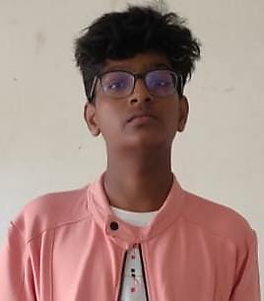
Team Members Details
Shaik Althaf
BE,1
Electrical and electronics engineering
I have a creative and logical mindset to analyze the real-world problems, so that i have participated in many projects as well as hackathons including Australian hackathon.
B Nafisa
BE,1
Aerospace
This is the first hackathon project I am undertaking and I am very much interested to explore and learn things.
Sriram V
BE,1
Computer science and technology
I have got selected in an Australian hackathon, and participated in many, I am talented in Elocution and hosting.

Slide 3
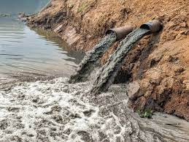
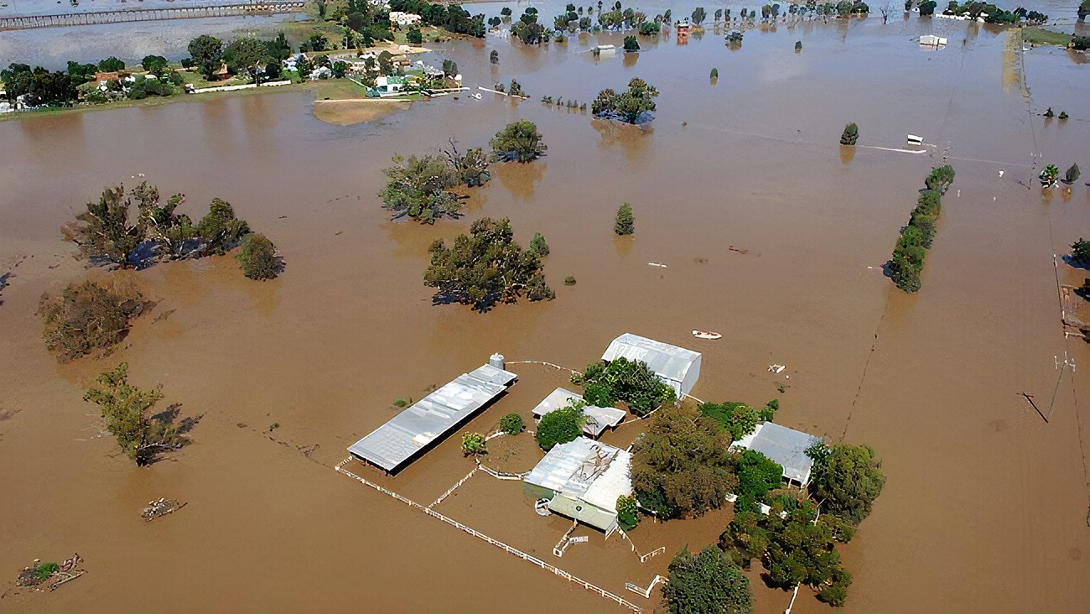
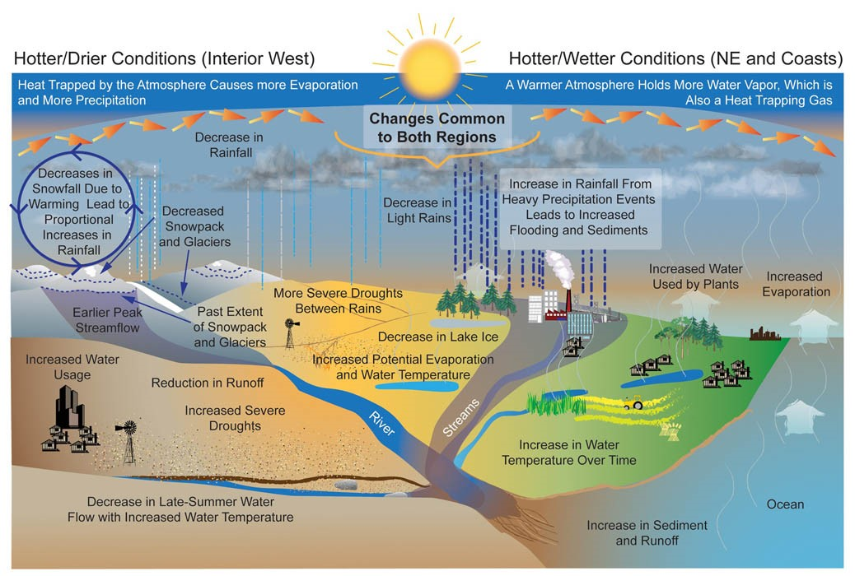
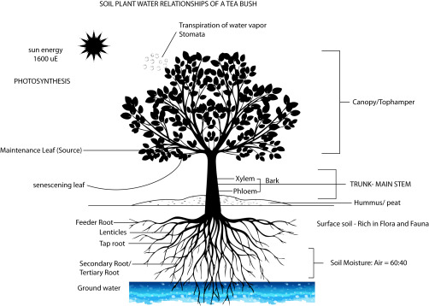
Challenge 1
Problem statement
Solution to handle environmental challenges like rain, temperature/humidity, changing water level and soil moisture.

Slide 4
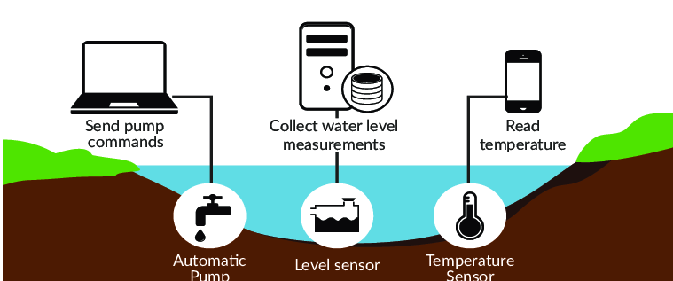
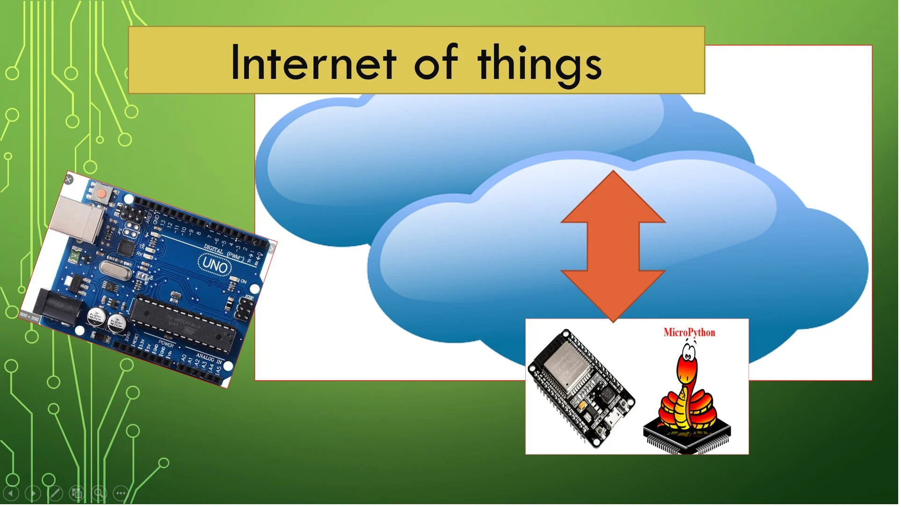
Objective :
To develop a prototype that continuously monitors rain, temperature, humidity, changing water level, and soil moisture and sends information to the control panel to undertake required actions.
And also to integrate the prototype with the ESP8266 Wi-Fi module for the users to get up to data information.

Slide 5
According to a Composite Water Management Index (CWMI) report nearly 600 million people, which is almost 50% of the country’s population, are facing water shortage issues.
Wastage water is enormous in India. Statistics from the Central Water Commission reveal that India receives as much as 4,000 billion cubic meters of rainfall, but only a mere 8% of that is stored efficiently.
Leaking pipes, limited or aging storage infrastructure like dams, and a lack of recycling systems like rainwater harvesting have worsened India’s water crisis

Slide 6
Proposed Solution
The proposed design scheme is a framework in which the sensors monitor continuously in remote places and interfaced through a cloud database.
Following are the main points of consideration :
To collect information from different sensors and send it to the base station through the NRF24L01 transceiver, so that the necessary action can be taken.
The Monitoring system is interfaced with the ESP8266 Wi-Fi module to alert the user and also by sending an appropriate message the users can visualize the readings.

Slide 7
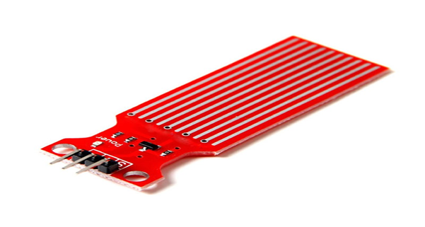
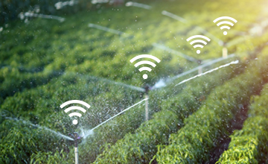
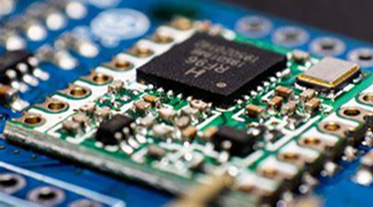
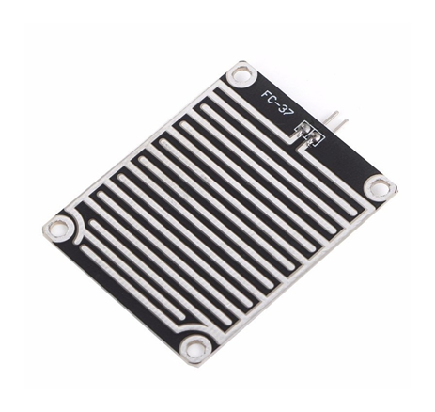
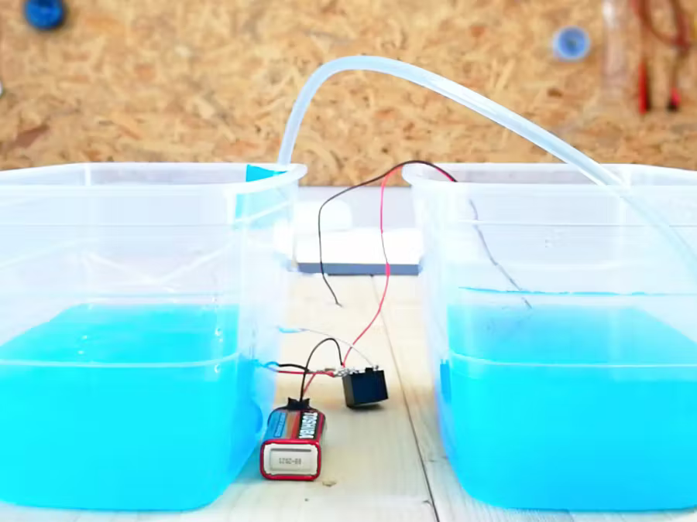
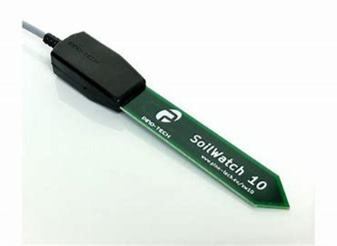
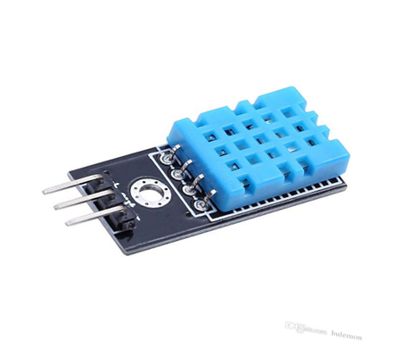
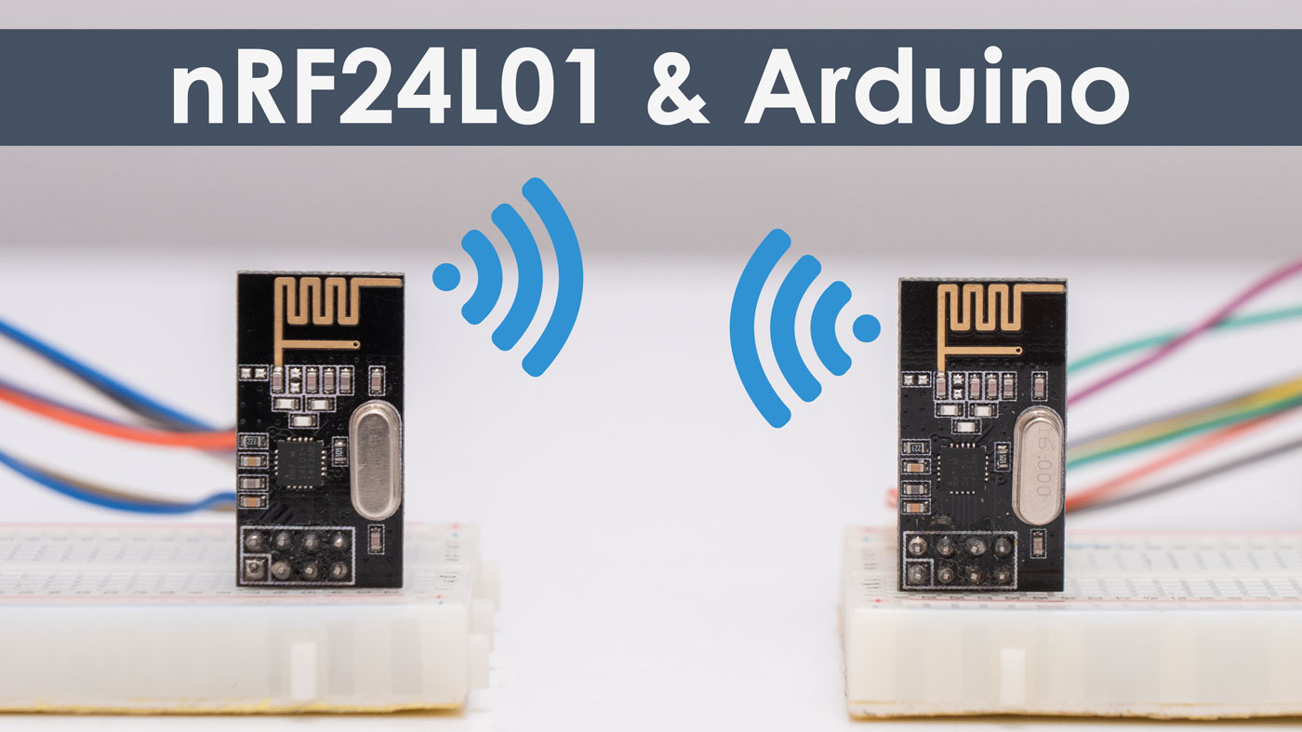
Smart Irrigation System
Water level sensor
Micro controller
(Arduino)
Rain sensor
Smart Pumping System
Soil moisture sensor
DHT11 temperature and humidity sensor
NRF24L01 Transceiver

Slide 8

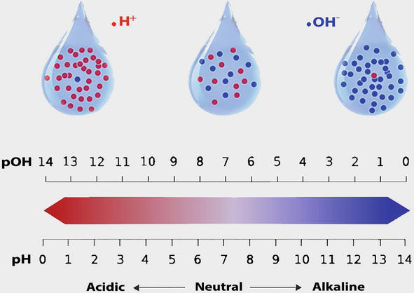
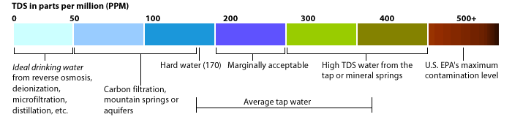
Challenge 3:
Problem statement
To monitor water parameters like pH, TDS and DO

Slide 9
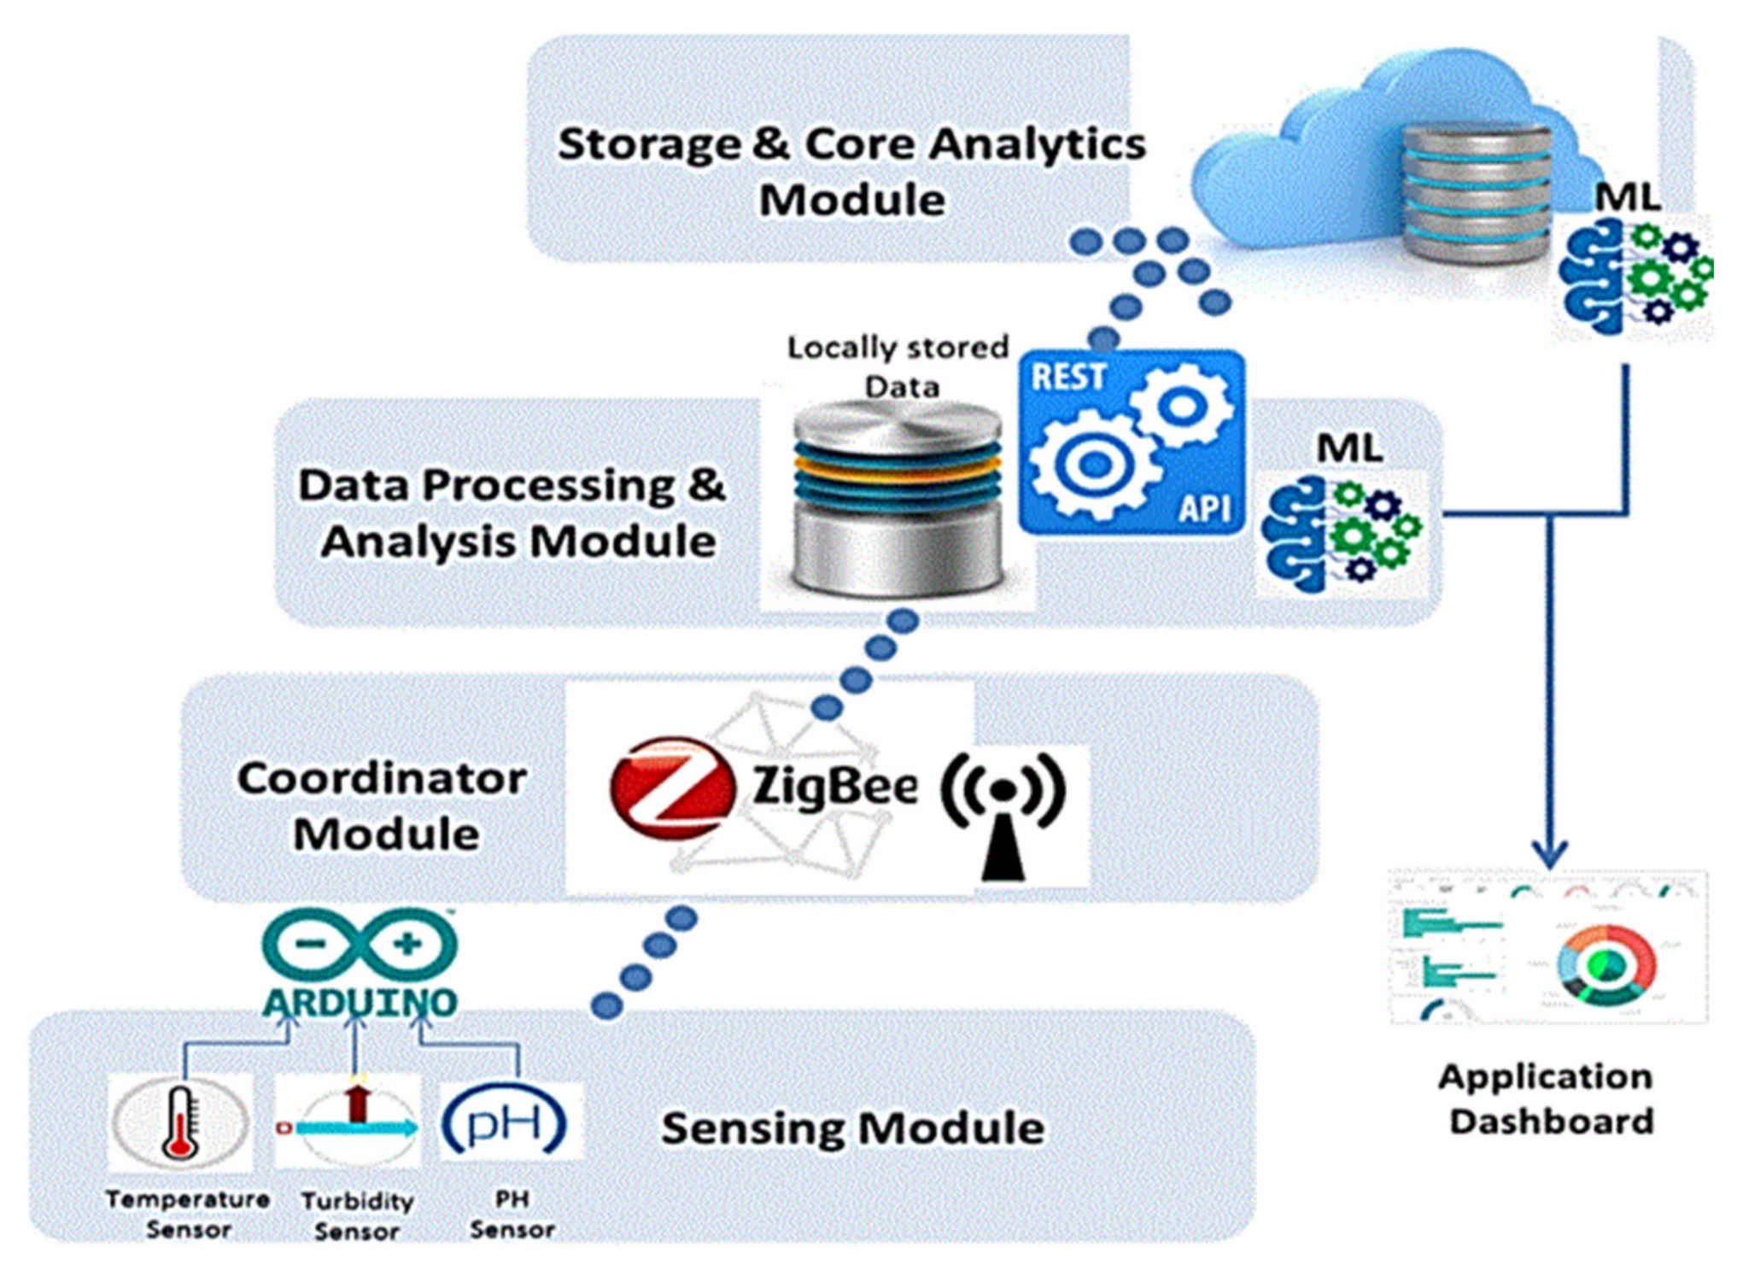
Objective :
To design a prototype that monitors the water quality parameters and alerts the user if the quality of water doesn’t coordinate with preset gauges to undertake required actions.
And also to integrate the prototype with the ESP8266 Wi-Fi module for the users to get up to data information.

Slide 10
TOTAL DISSOLVED SALTS:
Dissolved solids may be organic or inorganic compounds. If the dissolved solids in water exceed 300 mg/l it adversely affects living organism as well as industrial product.
pH:
Extreme values of pH can cause problems for aquatic fauna. Acidic pH corrodes the pipeline. The death of most aquatic fauna may result from extremely acidic or alkaline water. Alkaline pH decreases the efficiency of the disinfection process. A pH range of 6.5–8 is optimal for freshwater. A range of 8–9 is optimal for estuarine and sea water.
DISSOLVED OXYGEN:
It is considered an important measure of water quality as it is a direct indicator of an aquatic resources ability to support aquatic life. While each organism has its own DO tolerance range, waters with levels below 1 mg/L are considered hypoxic and devoid of life.

Slide 11
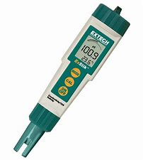
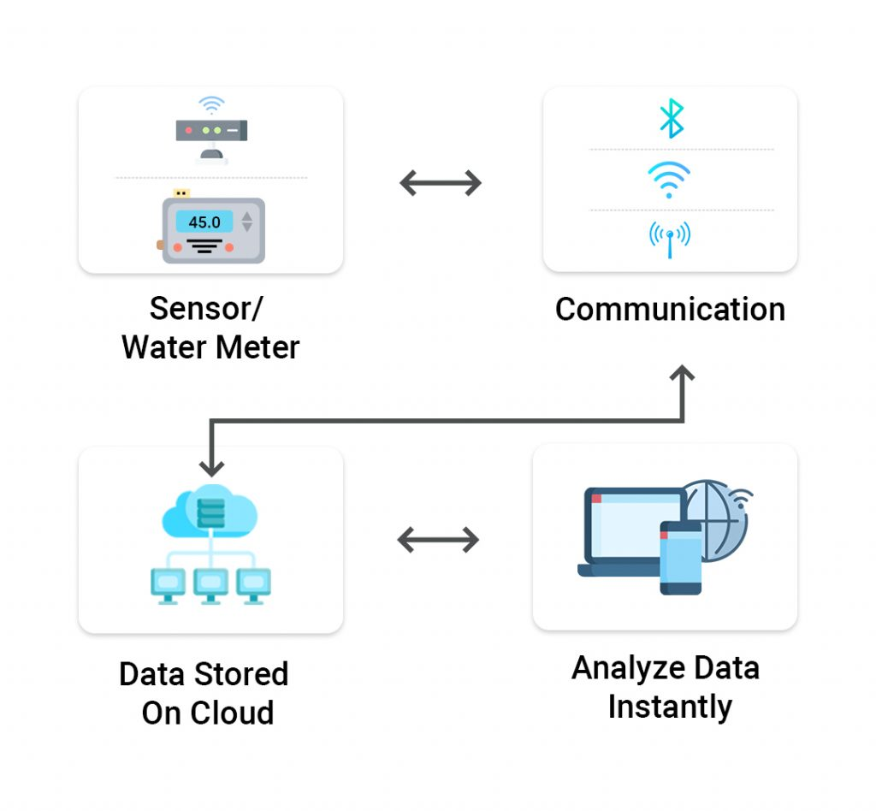

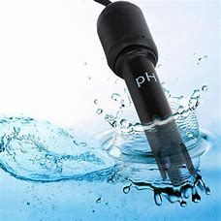
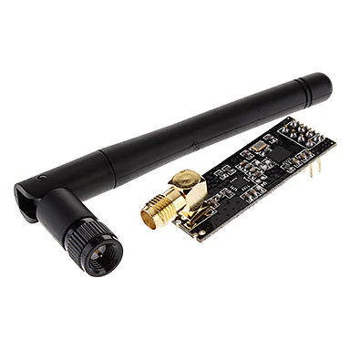
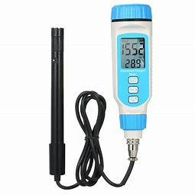
Transmitting Part
Receiving Part
Dissolved Salts Sensor
Microcontroller
Microcontroller
pH monitoring
sensor
Cloud Database
Dissolved Oxygen Sensor
DATA

Slide 12
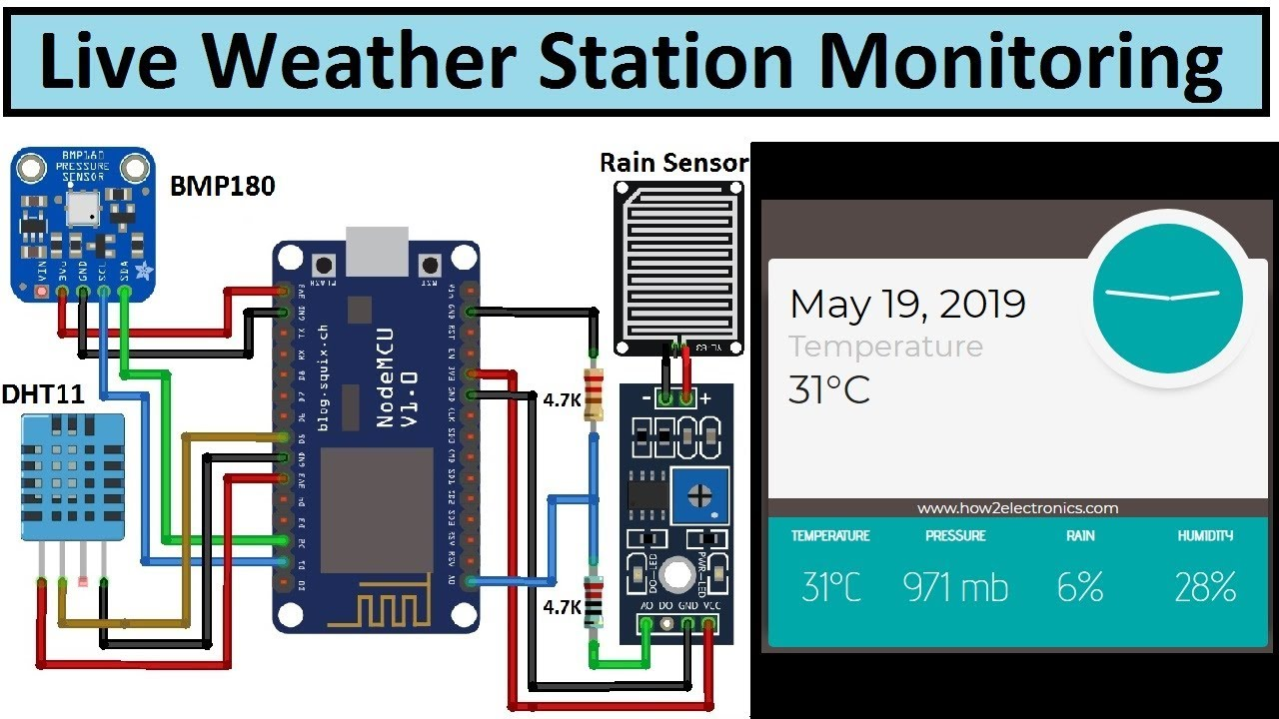
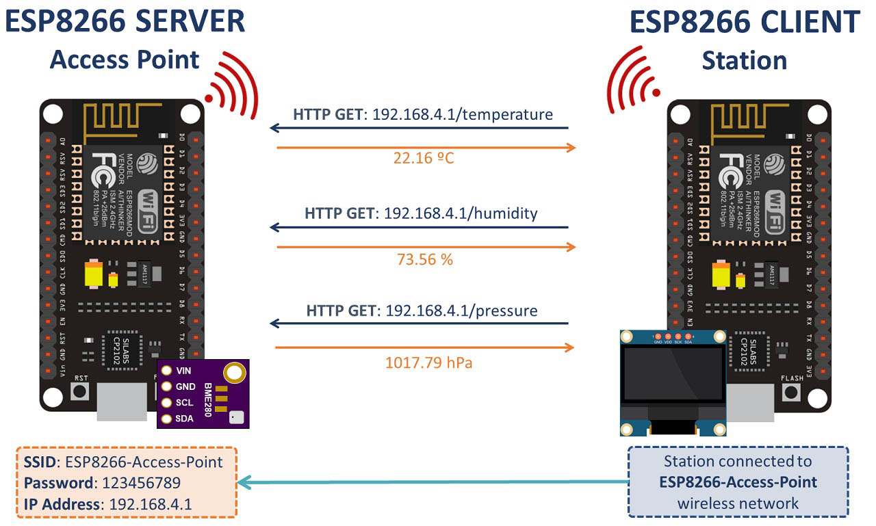
ESP8266 WiFi module:
The ESP8266 WiFi Module is a self-contained SOC (System On-chip) integrated with a TCP/IP protocol stack, which can provide microcontroller access to any type of Wi-Fi network.
It is referred to as a standalone wireless transceiver, available at a very low price .It provides the solutions to meet the requirements of industries of IoT such as cost, power, performance, and design Solution. .

Slide 13
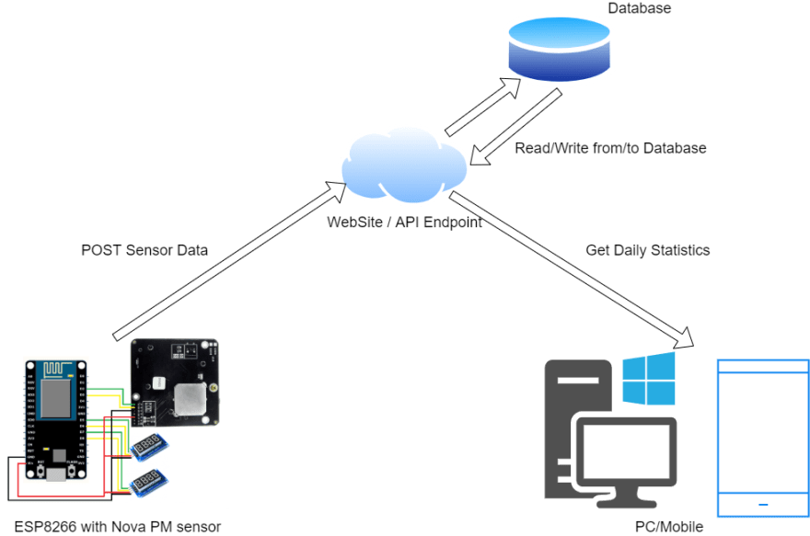
Solution:
The ESP8266 WiFi module is connected to the Arduino in the server area and the internet is provided to the module to fetch data to the user 24/7 from the sensors.
Conditioned monitoring of sensors designed to proactively alert users so that unplanned downtime can be prevented.
To offer advantages for users to make their operations run more effectively and reliably.

Slide 14







Business Model Canvas
Target Audience
Key Uniquences
Key Activities
Value propositions
Advantages
1)Activation of automatic system
2)Smart alert system to prevents flooding.
Alert message is received by the user
1)Alert the user if calibrated values doesn’t coordinate with preset guages.
2)Integration with cloud database.
3)Alerts the users if sensors are in out of range.
4)Monitors water quality parameters
1)Farmers
2)Pollution control board
1)Cost Effective ₹4500
2)Easy to setup and use
3)Updated information for 24/7
Key Resources
Channels
1) It can be used in remote places.
Direct stores

Slide 15
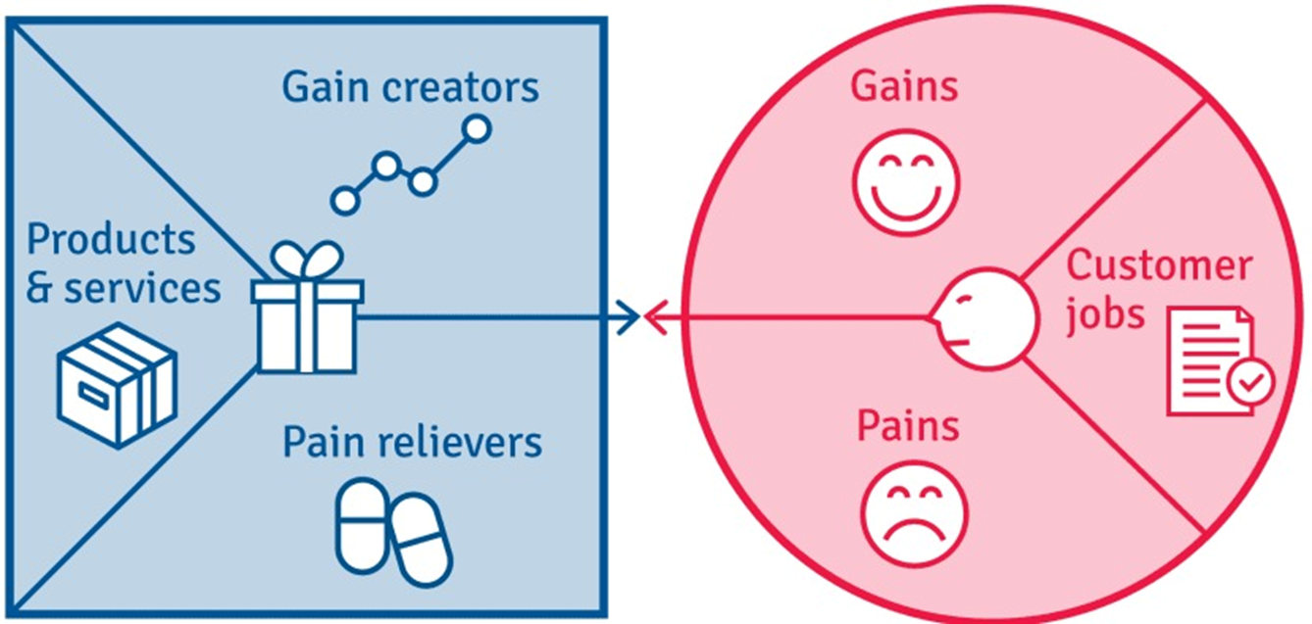
Gain:
1)prevents flooding
2)promotes rain water harvesting.
3)Assured quality of water.
4)Efficient storage of water.
Pain:
1)Unable to predict whether the rain is heavy or low

Slide 16

Challenge 2
Problem statement:
To propose a solution to handle theft or damage

Slide 17
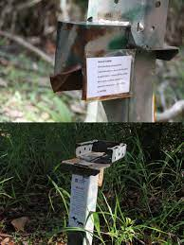
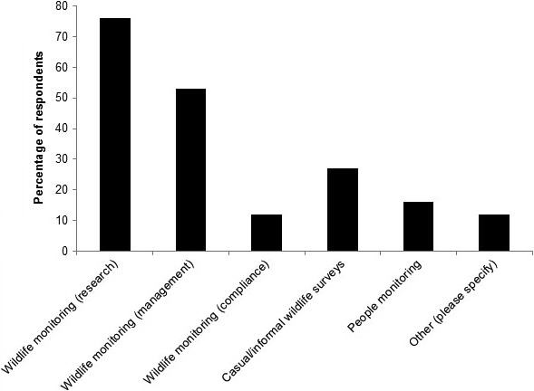
In India, there were over 873 theft cases per 100,000 inhabitants reported in the union territory of Delhi in 2020

Slide 18
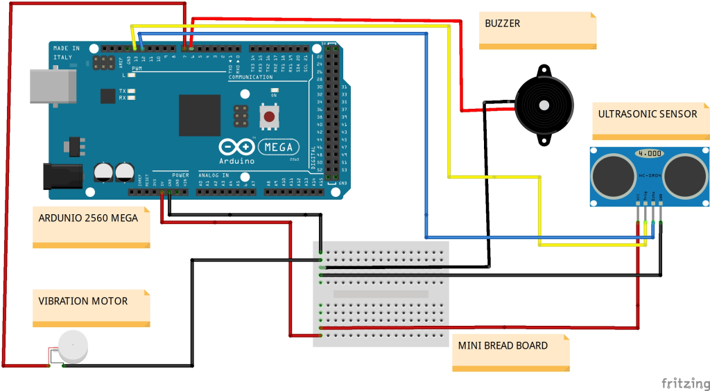
Objective:
To develop a prototype that continuously monitors vibration and helps in identifying theft using ultrasonic and camera sensor to prevent damage and warns by sending an alarm signal
And also to integrate the prototype with the ESP8266 Wi-Fi module for the users to get up to data information.

Slide 19
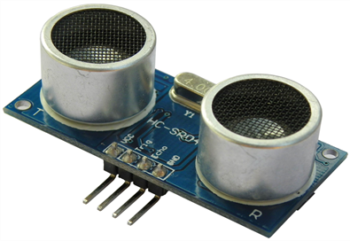
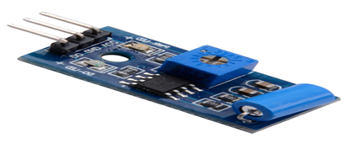

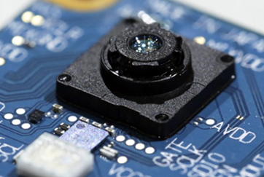
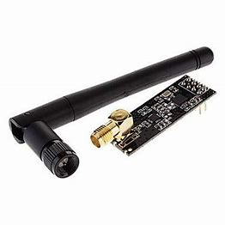
Ultrasonic sensor
Vibration sensor
Micro controller
Camera sensor
NRF24L01
transceiver

Slide 20
Transmitting Part
Receiving Part
Vibration sensor
Microcontroller
Microcontroller
Ultra sonic sensor
Cloud Database
Camera sensor
DATA

Slide 21
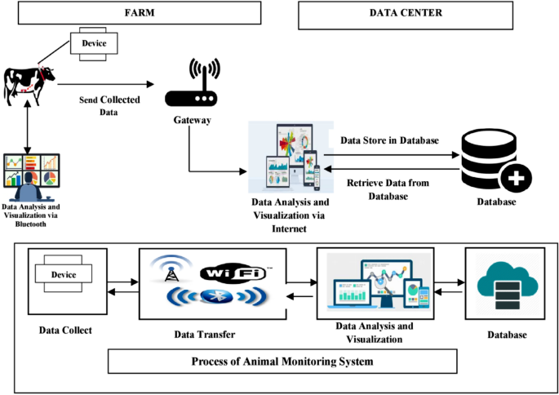
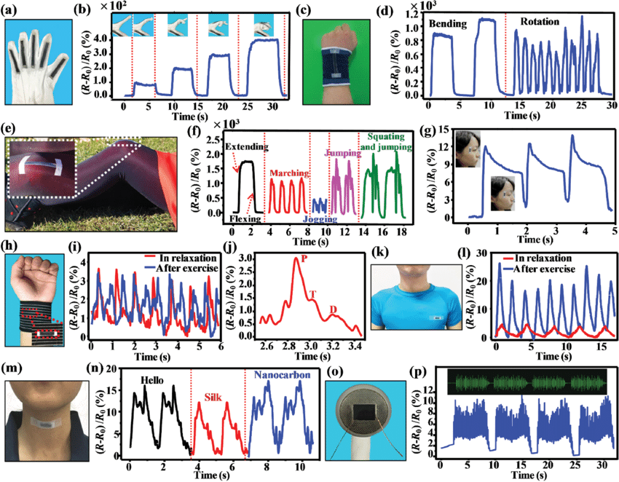
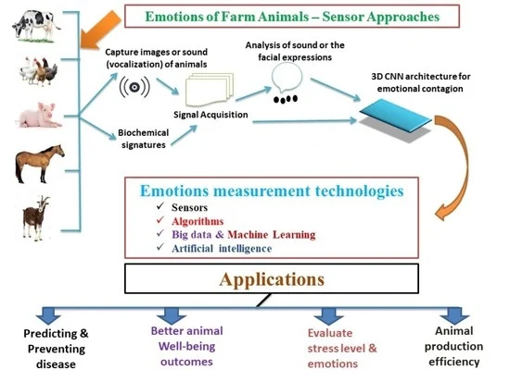
Challenge 4
Problem statement:
Sound / video feeds to identify any movement of classify it as human, animal, bird.

Slide 22
Increasing demand for food and traditional medicines, multiplying local wars and conflicts, and expanding legal and illegal market trade has exacerbated the wildlife crisis in recent years, damaging ecosystems and driving many species to the verge of extinction.
The illegal wildlife trade for meat and medicines poses a major threat to forest ecosystems, despite the Convention on International Trade in Endangered Species of Wild Fauna and Flora (CITES), due to difficulties with enforcement, say scientists with the Center for International Forestry Research (CIFOR) in a recent research paper published in the Annual Review of Environment and Resources.

Slide 23
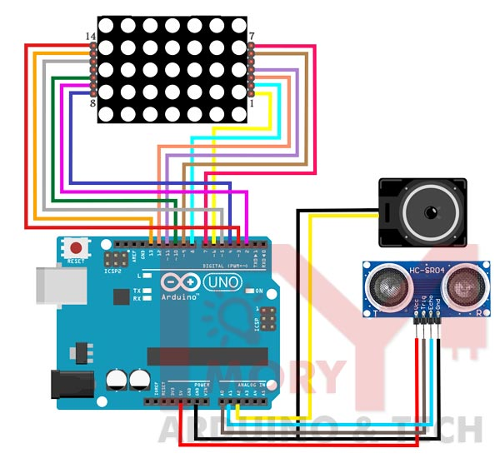
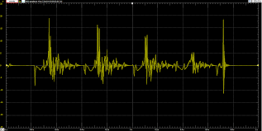
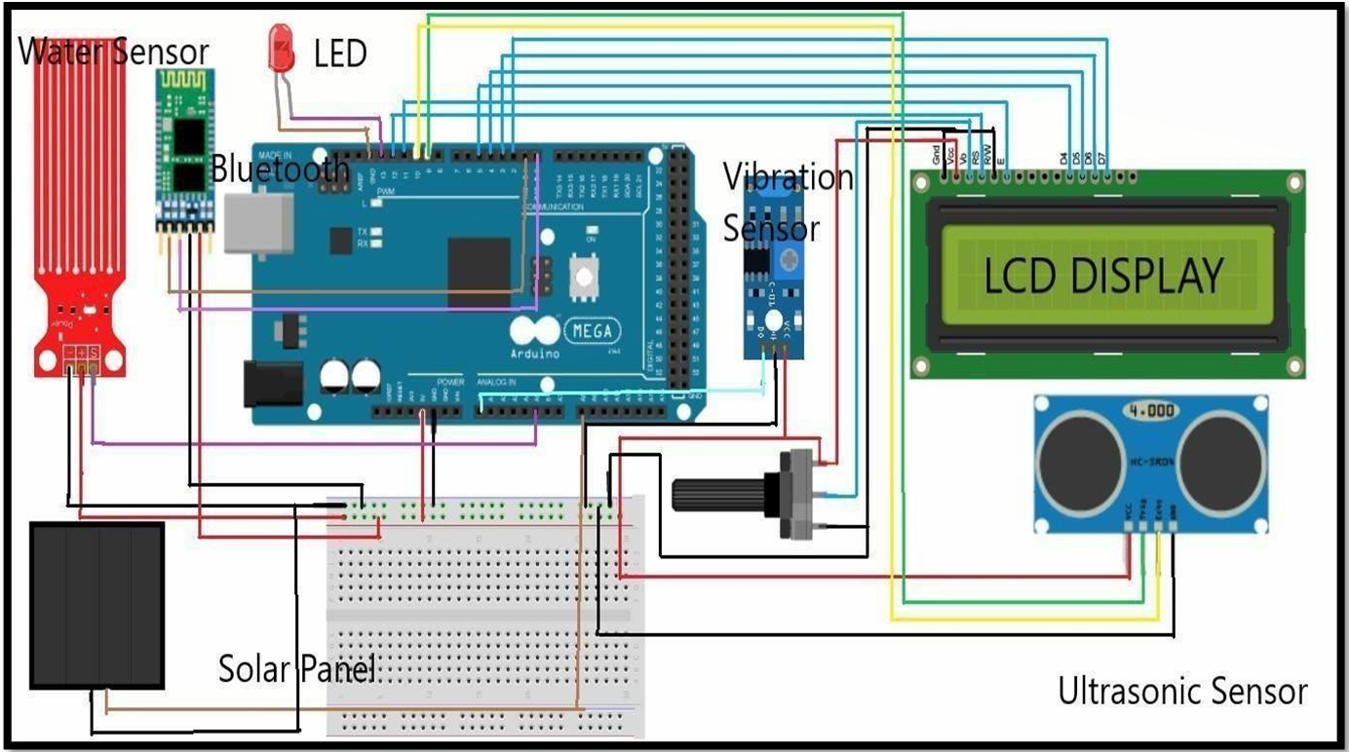
Objective :
To develop a prototype that monitors the vibration and movement of humans, animals and birds and sends an alert message to user to prevent intrusion.

Slide 24
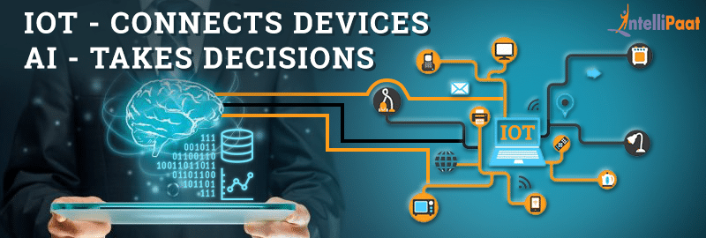
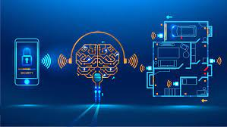
Proposed solution for challenge 2 and 4
The prototype consists of a vibration sensor, ultrasonic sensor and camera sensor.
When vibration is detected the ultrasonic sensor is activated and the obstacle which is approaching (within 400 cm) the target is detected and classified whether it is a human or animal or bird by integrating Artificial Intelligence with the module.
Thus it prevents theft and the classification of humans, animals or birds is achieved.

Slide 25
Business Model Canvas
Key Partner
Key Uniquences
Value Propositions
Customer Relationship
Customer Segments
1)24/7 data accessible by the user
1)Public
2)Forest Officer
1)Public
2)Forest Officer
Alert message is received by the user
1)Public
2)Forest Officer
Key Resources
Channels
1) It can be used in remote places.
2)Lawyers support for court hearing will all available
evidences
Direct stores

Slide 26
Gain:
Reduces the theft rate.
Protected wildlife.
Pain:
Unable to classify three species when there is a group of species in front of the camera.

Slide 27
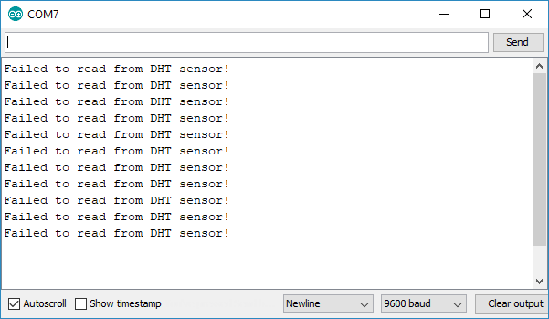
Challenge 5
Problem statement
To alert if challenge 3 and challenge 4 are out of range.

Slide 28
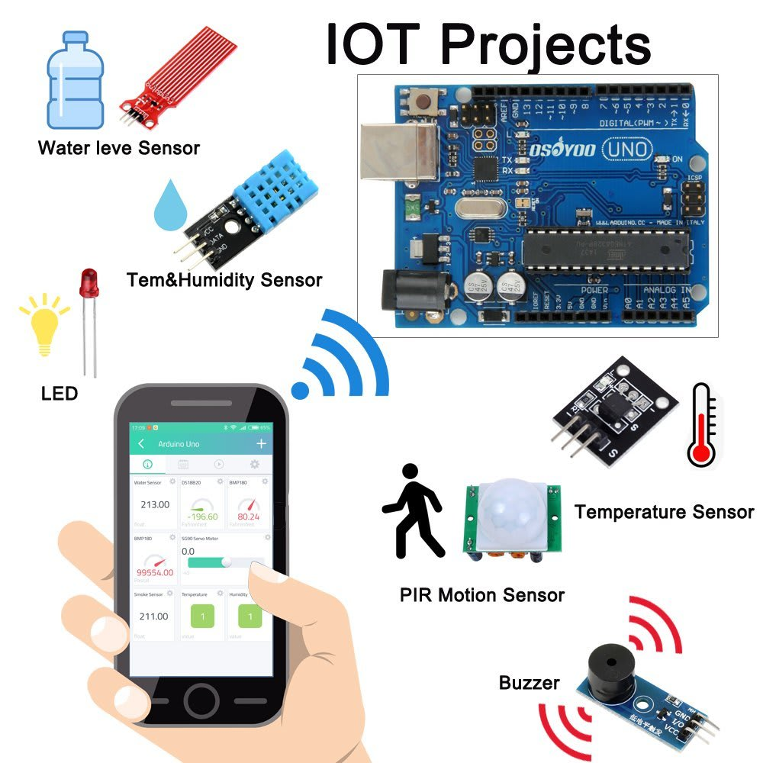
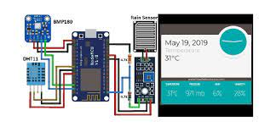
Objective :
To send an alert signal to the user using WiFi module if any of the sensors used in challenge 3 and 4 are in out of range

